Slide 1
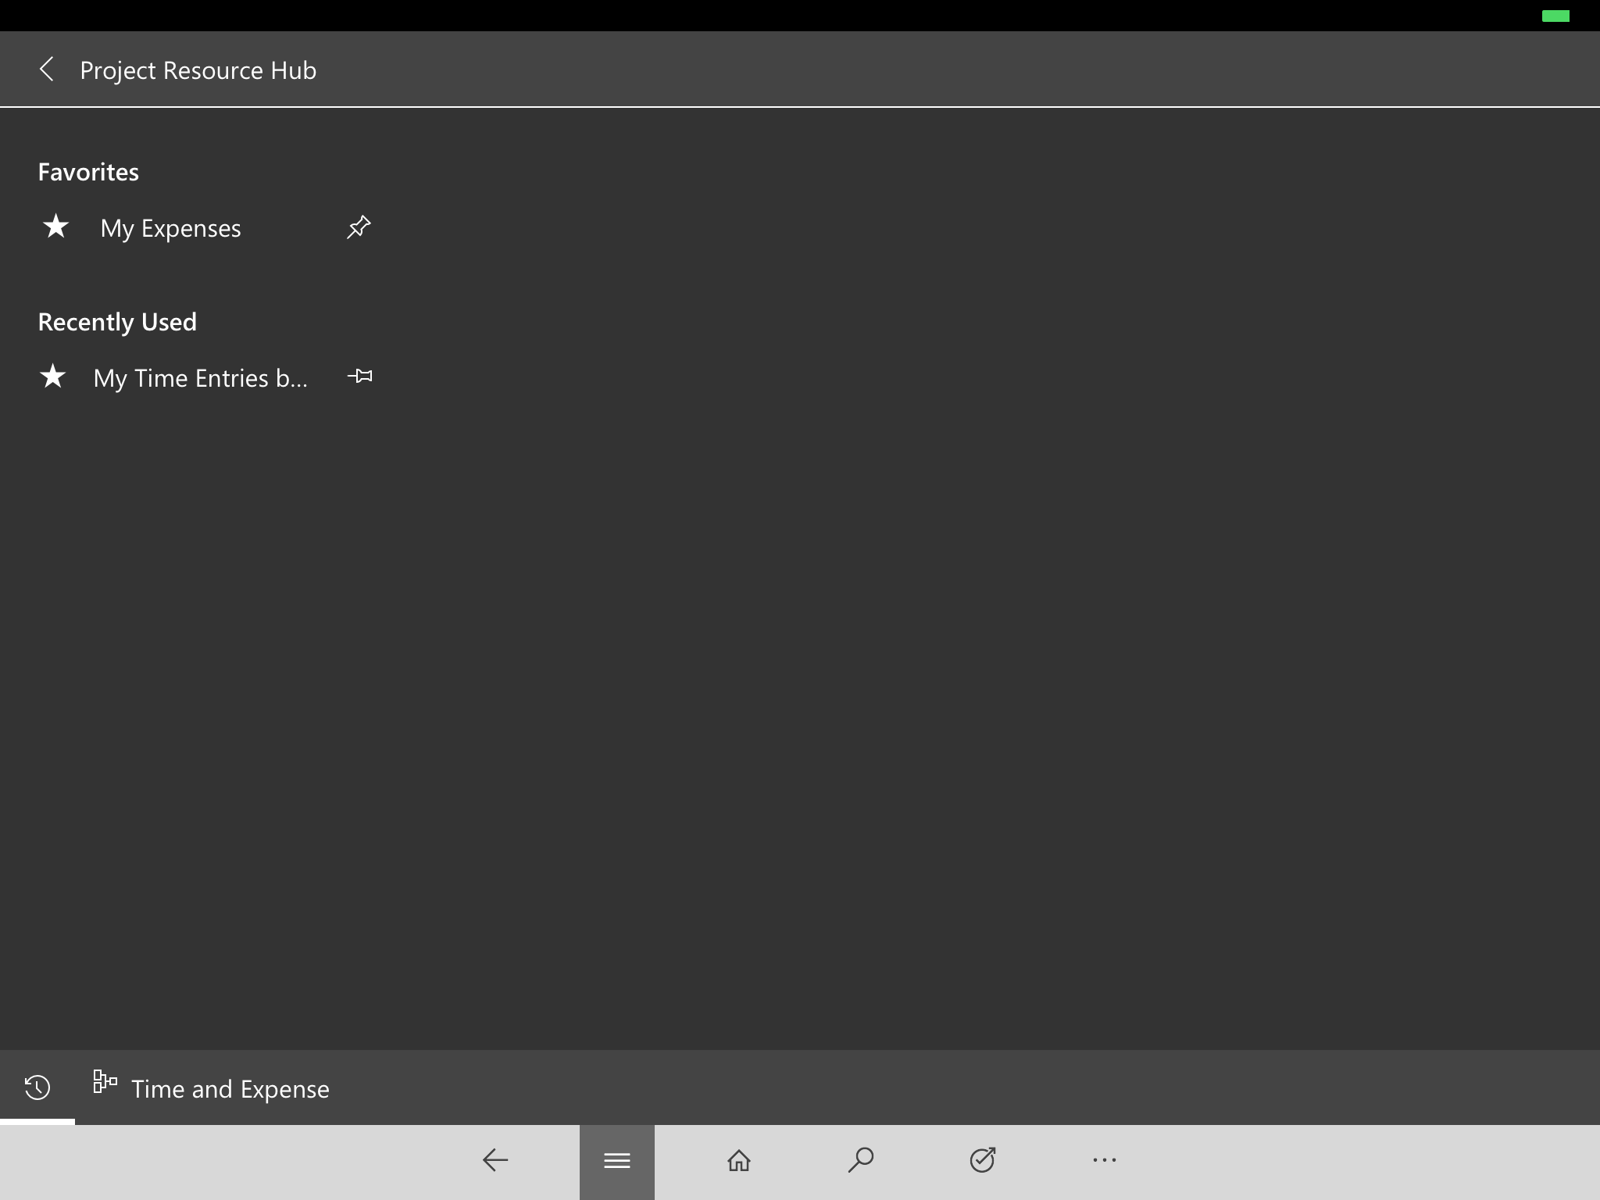
Tap a pin to add as a favorite
Choose the Favorites button to see favs and recently used records

